Slide 1
Appalachian Coal Country
Watershed Team
State College -- August 13, 2008

Slide 2
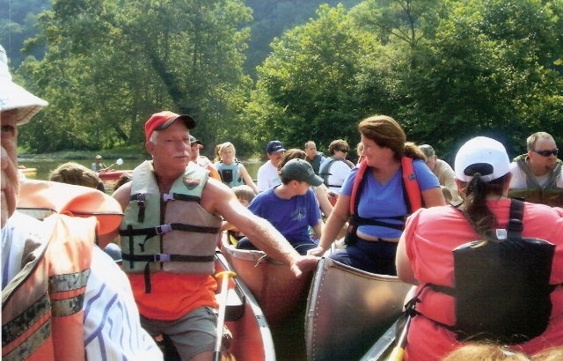
Notes:
For many years, watershed groups in Pennsylvania have brought new hope to their communities. The Appalachian Coal Country Watershed Team is here to assist in these important efforts.
We feel that the inclusive environmental work performed by watershed organizations can engage communities to relearn self-governance, becoming more involved in their own fate -- and energize people for change.
The work of the ACCWT incorporates a drive to clean up environmental blight in watersheds with a drive to increase investment in impoverished communities and to develop outreach projects that celebrate a proud coal-mining heritage, building partnerships and community pride at every step.

Slide 3
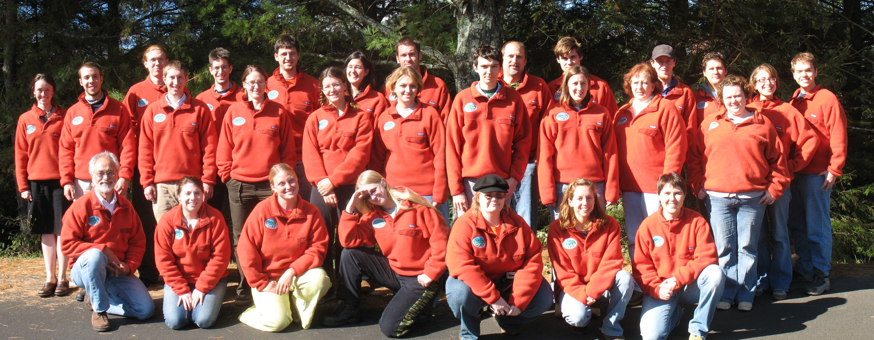
The Appalachian Coal Country Watershed Team
Fall 2007
Notes:
Our recipe for helping watershed groups:
This is our team, a “small army” of remarkable college graduates who each commit to 1-2 years of service for a rural Appalachian watershed affected by pre-regulatory coal mining. Each of these individuals is paired up with a local watershed effort in one of the eight states we serve.

Slide 4
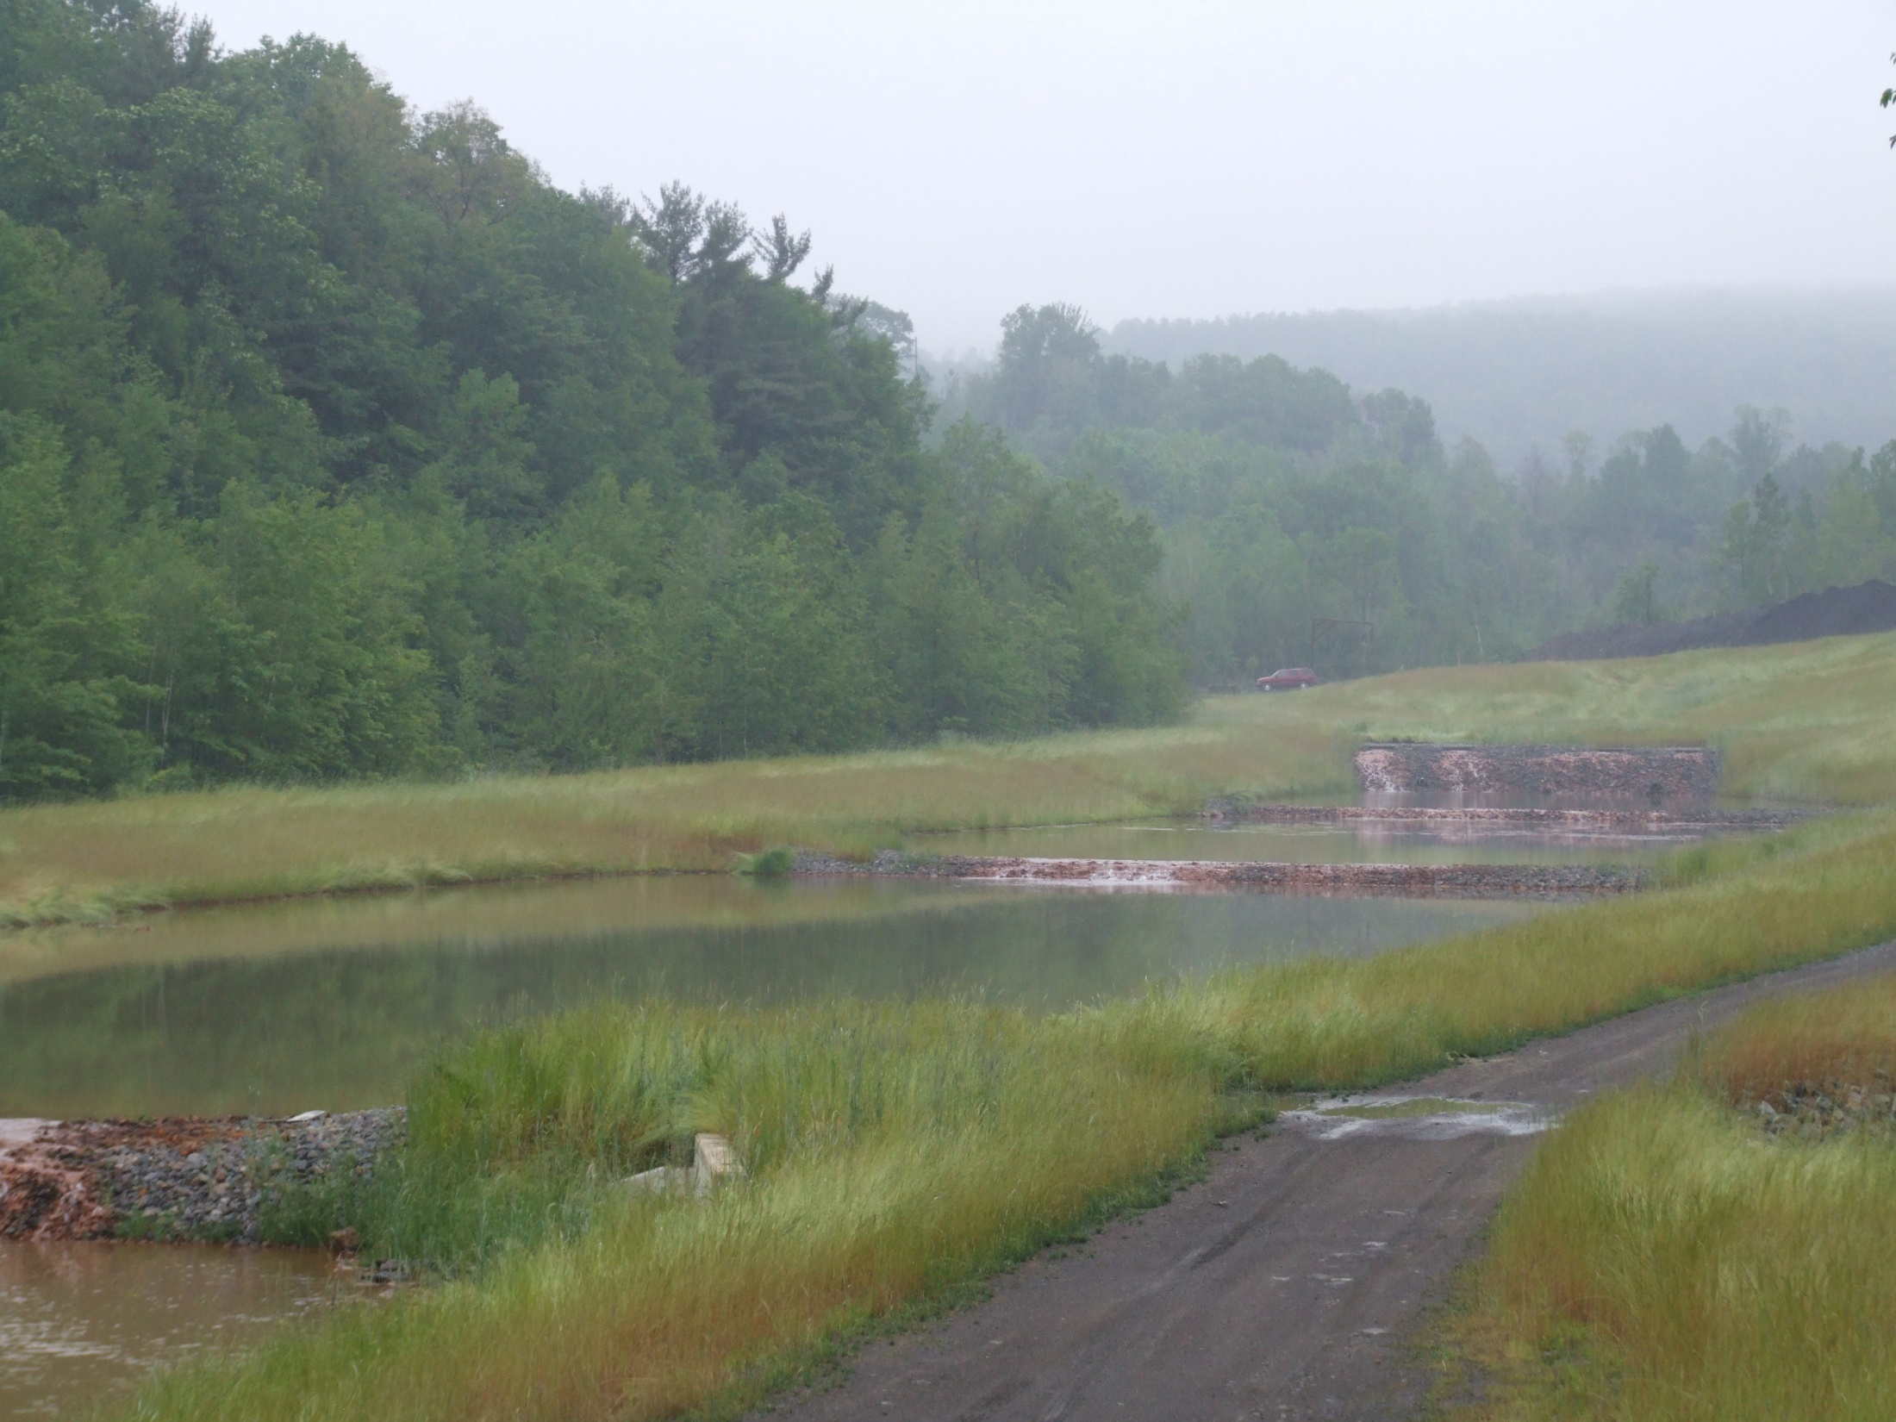
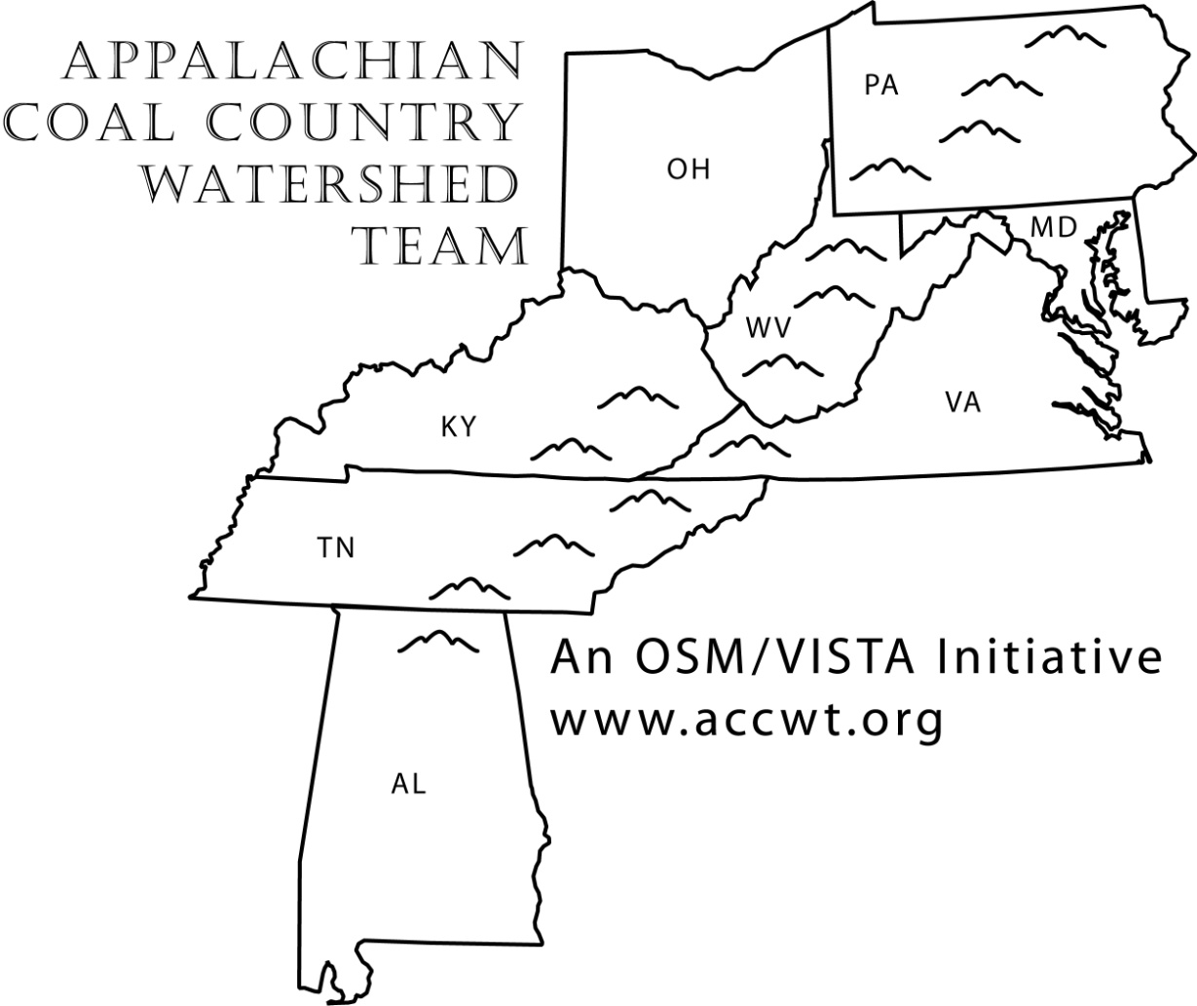
Notes:
Our team works in 8 Appalachian states from PA to Alabama. Currently we have over 30 OSM/VISTAs in the field…boots on the ground! And are actively recruiting for more.

Slide 5
How the pieces fit together:
OSM
AmeriCorps VISTA
ACCWT

Slide 6
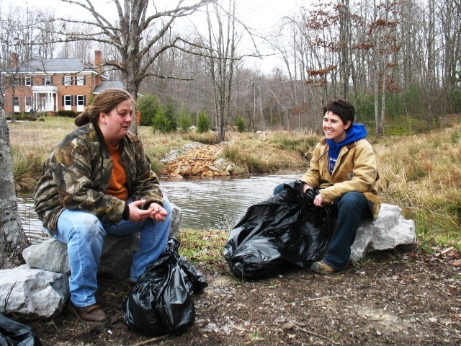
Project Examples
Notes:
OSM/VISTAs work full-time support to the people and communities of Appalachia.
Our OSM/VISTAs work within 5 core goals in their communities. Here with me are Catherine Webster and Carly Trumann, OSM/VISTAs from the anthracite region of Pennsylvania who will tell you more about their impressive work.

Slide 7
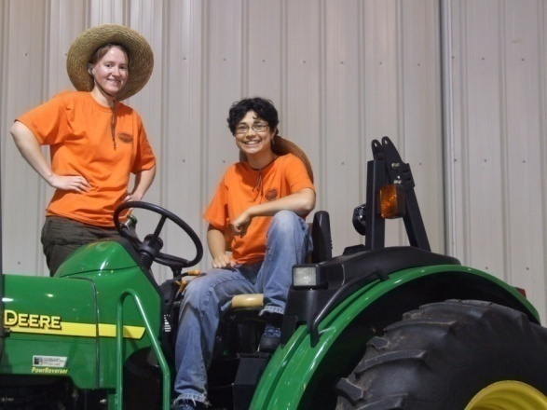
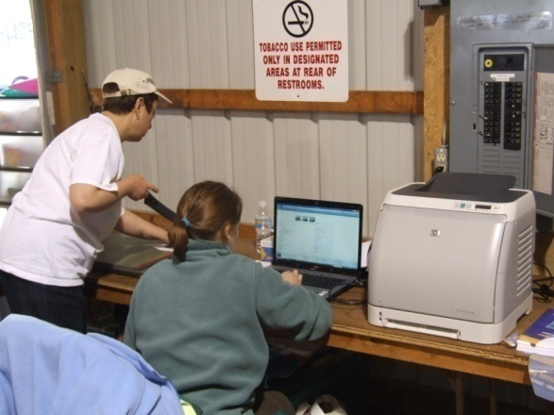
Core Goal One:
Build capacity to enable the long-term stability and success of issue related projects.
Outreach
Press Releases
Grant Writing
Board Organization

Slide 8
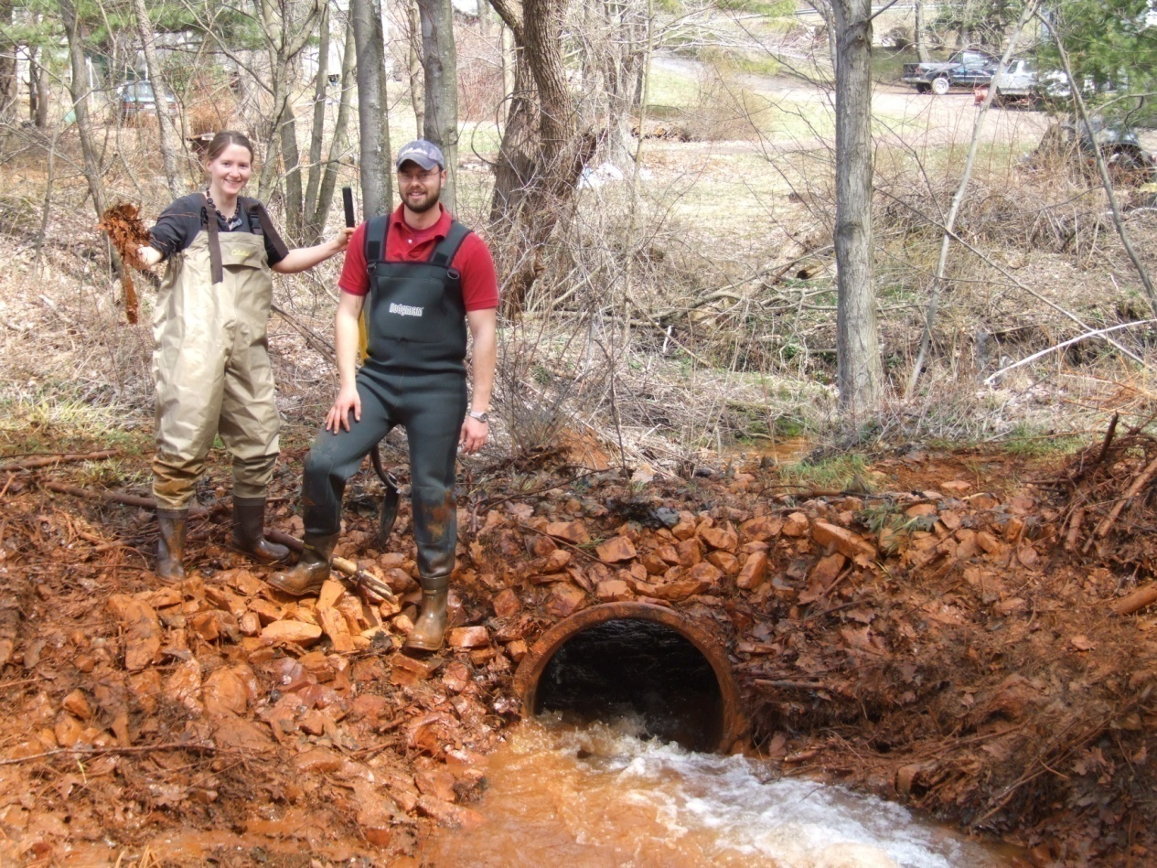
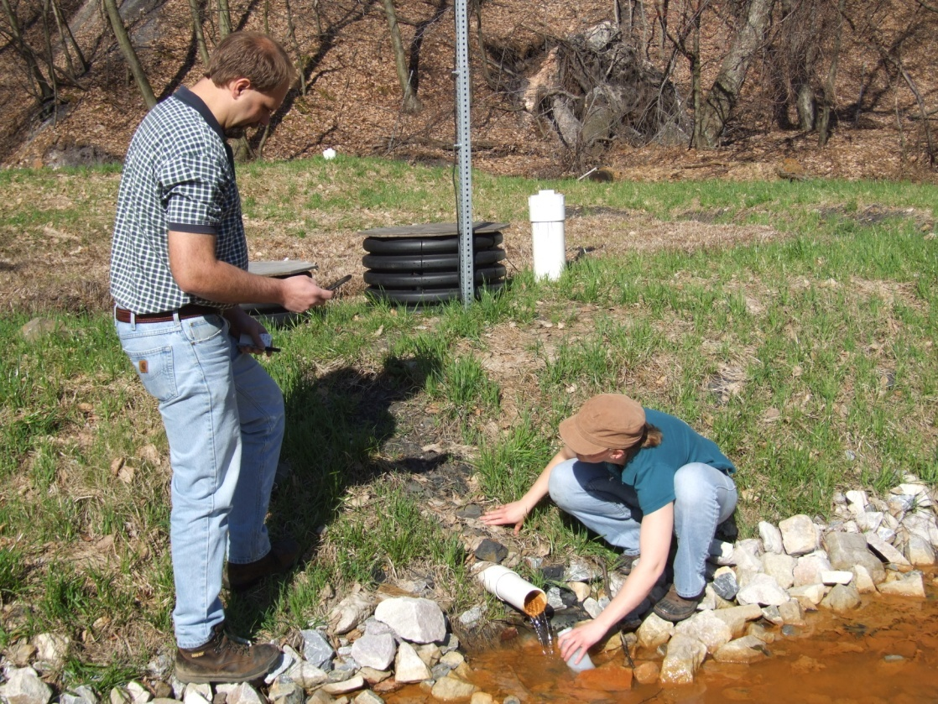
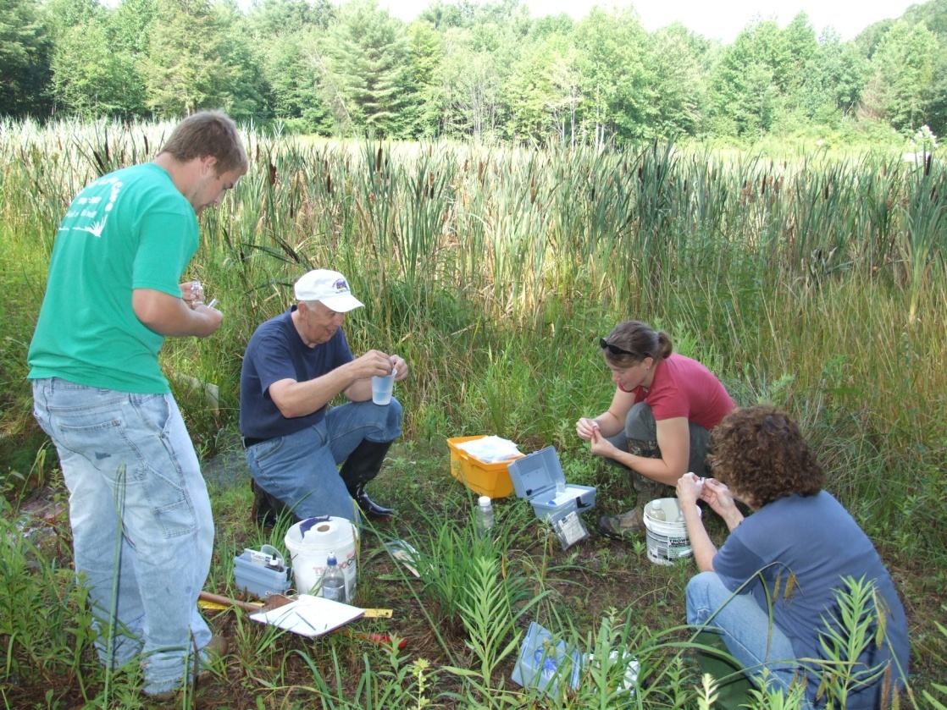
Core Goal Two:
Assist sponsor organization in conducting the watershed research and water quality monitoring critical to future funding.

Slide 9
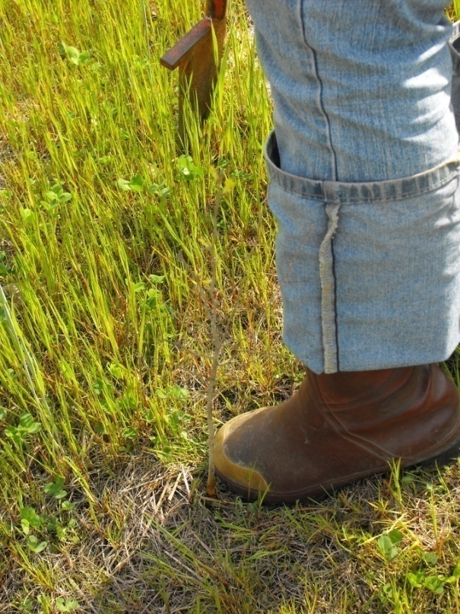
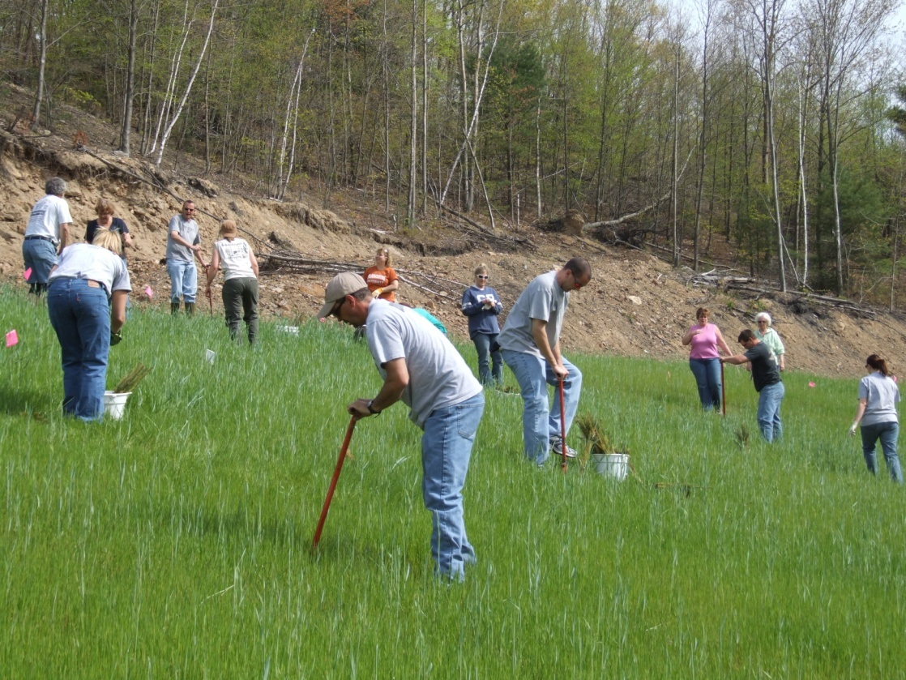
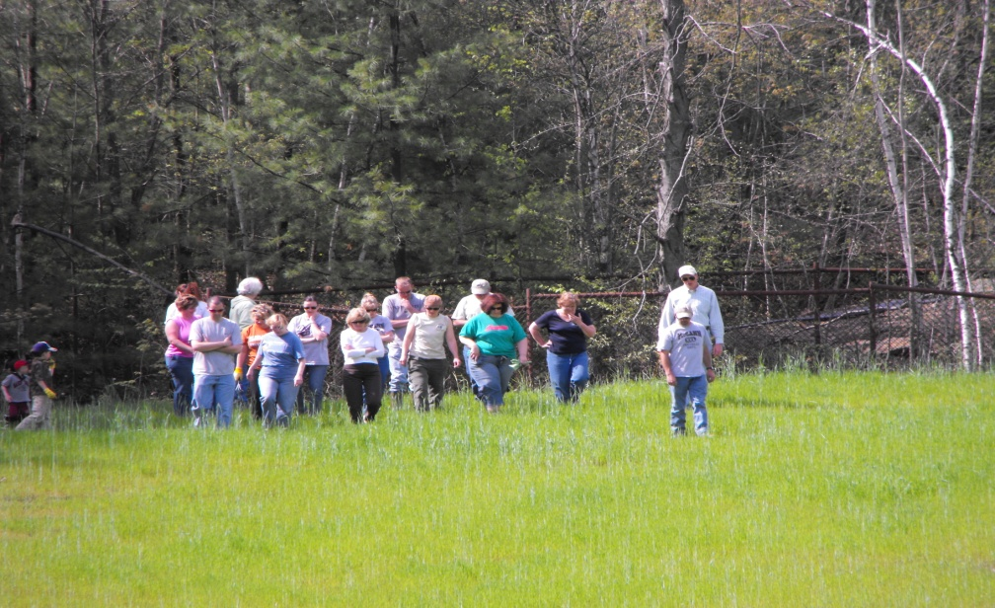
Pine Forest Tree Planting:
A need
28 class members
400 trees
< 2 hours of work

Slide 10
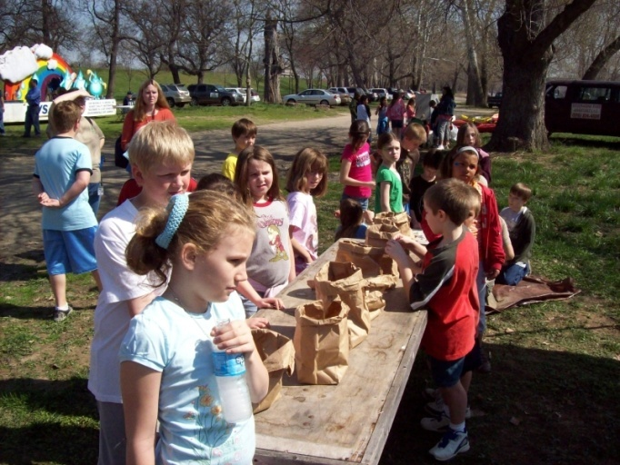
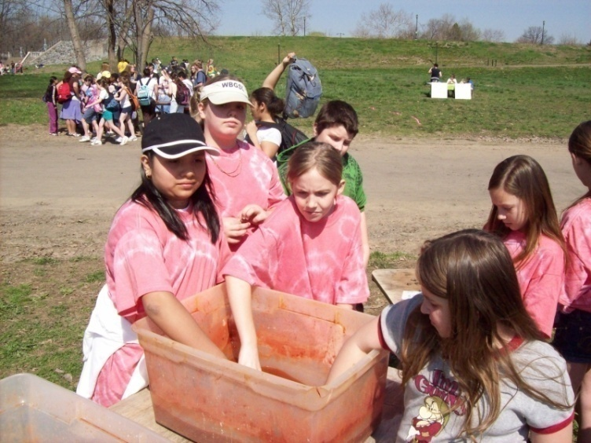
Core Goal Three:
Enhance community awareness and involvement through community education and outreach.
Coordinating workshops with schools and youth groups
Creating publications to inform public of watershed issues
Tabling at community events and festivals

Slide 11
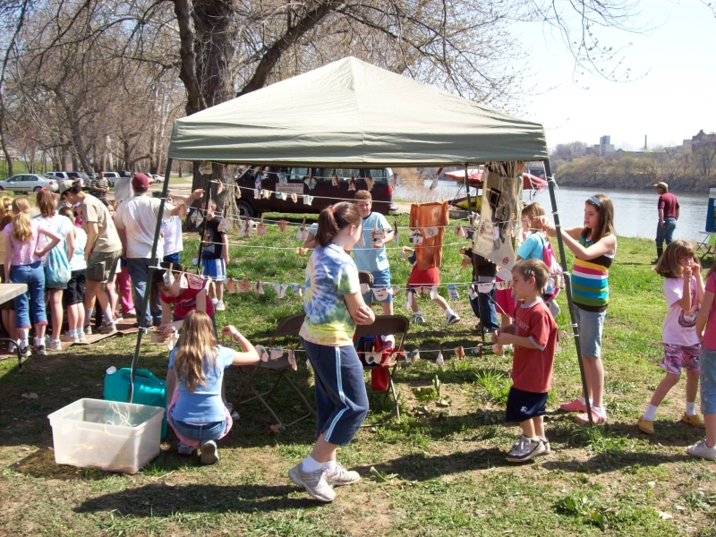
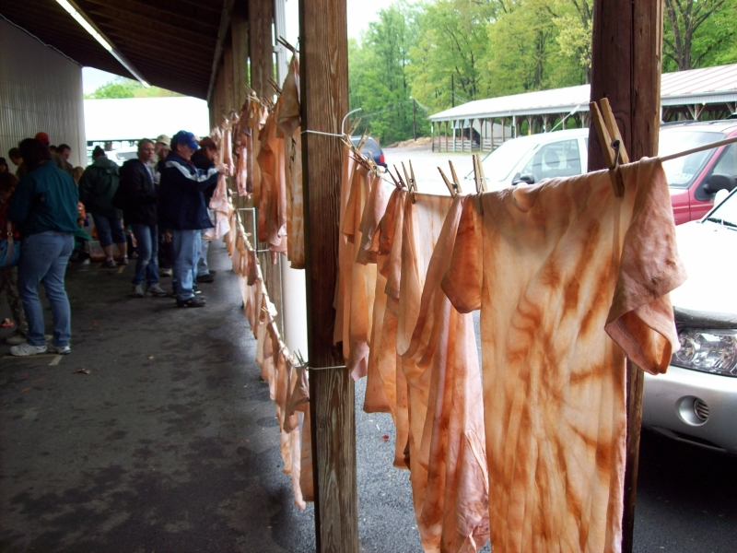

Slide 12
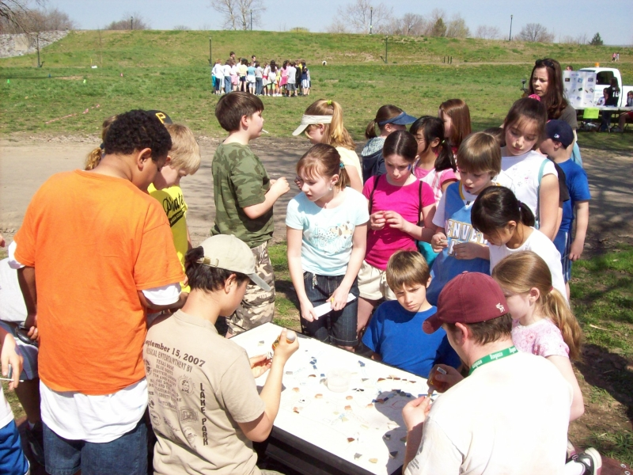
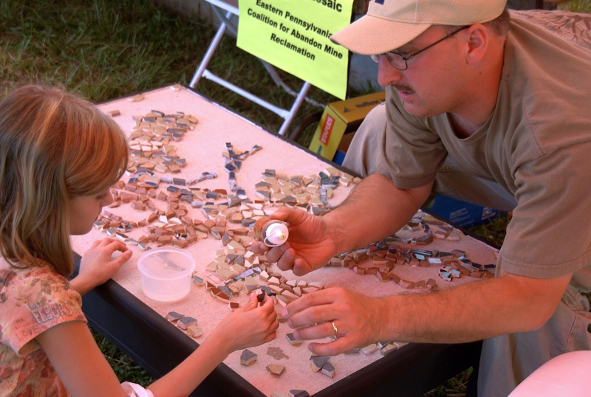
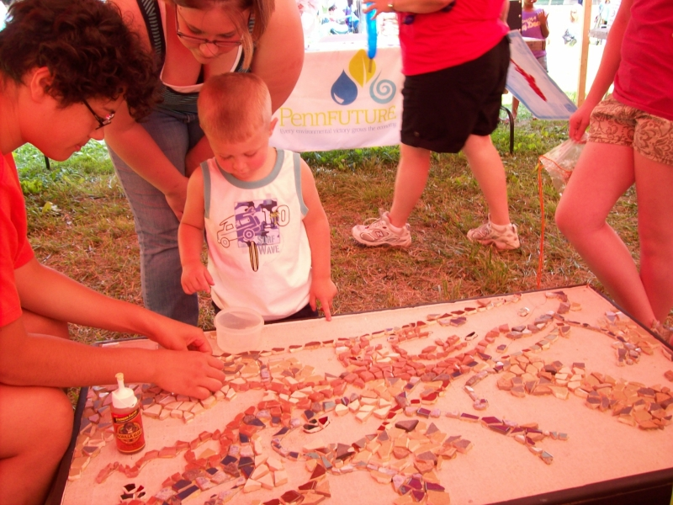

Slide 13
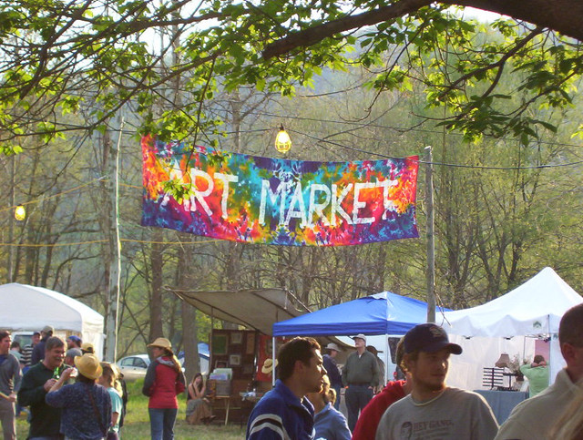
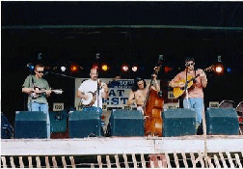
Core Goal Four:
Support the efforts of community revitalization through economic development projects and celebrate and increase the awareness and understanding of local history and culture.
OSM/VISTA Drake Asberry with Friends of the Cheat:
Cheat Fest Fairgrounds Project

Slide 14
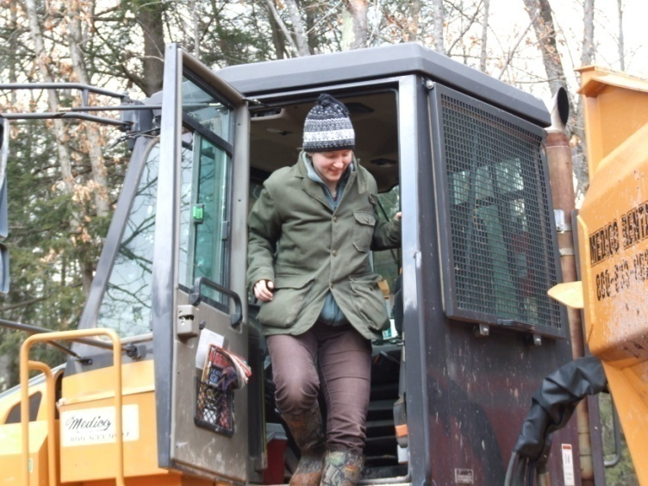
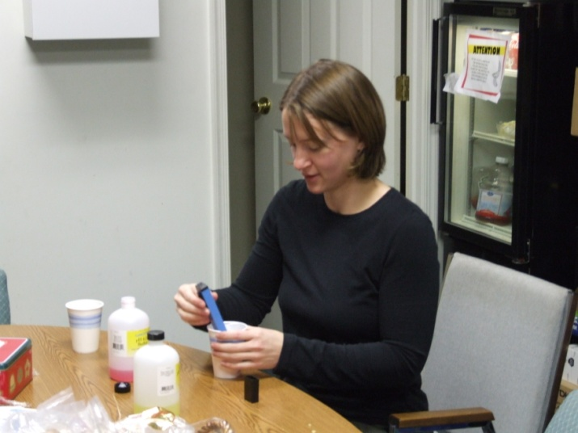
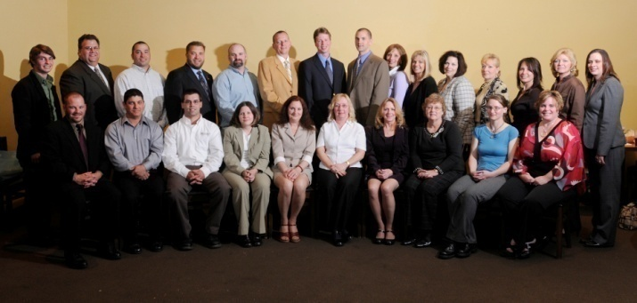
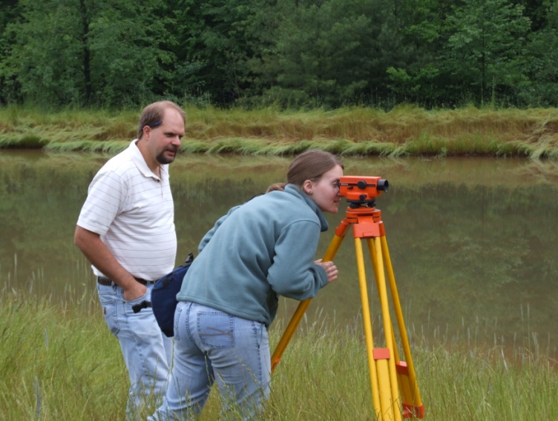
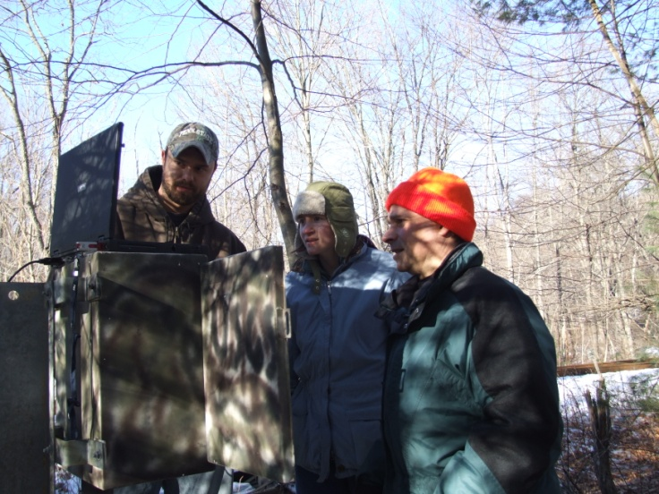
Core Goal Five:
Provide Professional Development for the OSM/VISTA
Networking
Presentations
Professional & Technical Writing
Other Skill Building

Slide 15
Notes:
One of the most exciting features of our program is its track record in bringing young talent into the region and keeping it there – or enabling educated, talented local people to stay and become “environmental professionals” in their home regions. One or two years with a watershed organization gives OSM/VISTAs a chance to build strong connections in their rural host communities and to become deeply committed to the area they are working in. To the delight of their watershed organizations, they sometimes find the ways and means to turn their work into a full-time, paid position.
Shown here is one great example – Kelly Martin, originally an OSM/VISTA for Georges Creek Watershed Association. After two successfully ears in that position, Kelly built on her knowledge and expertise enough to be hired by the Chesapeake Bay Trust as a regional coordinator for the Chesapeake Bay watershed portions of the Western MD highlands. She now coordinates watershed restoration efforts among five watershed organizations and local agencies, and supervises an OSM/VISTA herself.
We are currently exploring ways to incentivate this deeper, longer-term commitment by providing housing assistance and other rewards to 2nd-year OSM/VISTAs.
By bringing new talent to the region and giving talented individuals an opportunity to become committed to and established in our rural watersheds we are building capacity and new, next-generation leadership not just for individuals but for the region as a whole.

Slide 16
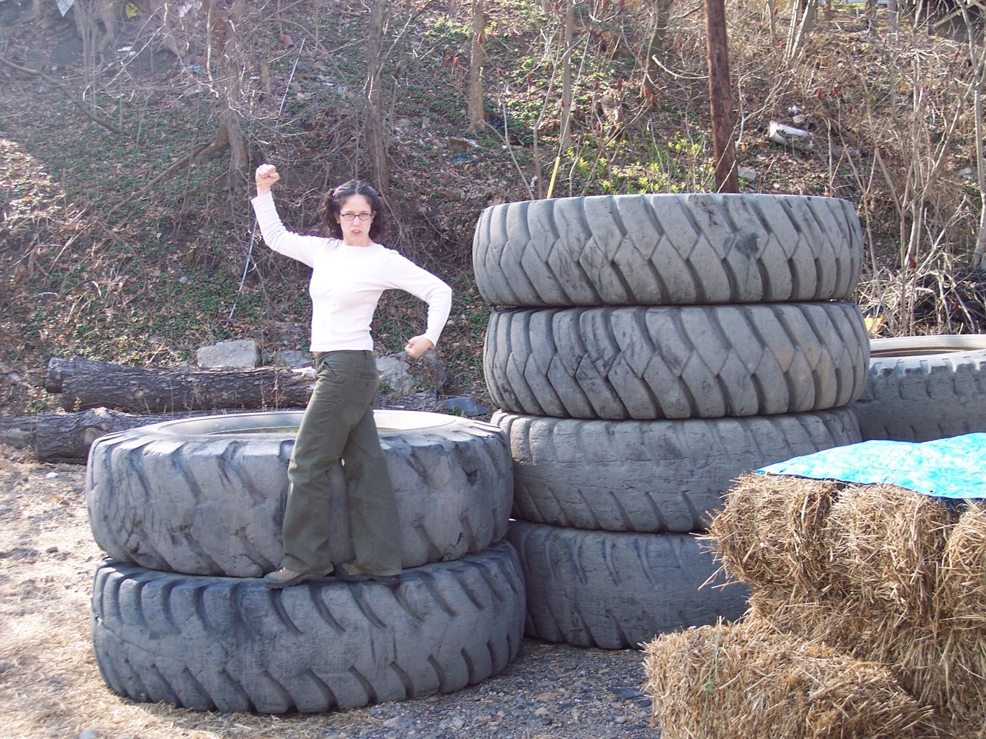

Slide 17
Team Accomplishments since 2002:
Provided 130 years of OSM/VISTA service since 2002
Recruited over 100 OSM/VISTAs
Leveraged a total of over 110,000 hours of service from community volunteers!
Secured $5.7 million in in-kind donations, and $3.8 million in grants and monetary donations.
Notes:
Our success

Slide 18
Ingredients for an OSM/VISTA Project
Community-oriented watershed project -- aimed at sustainable community change and getting citizens involved
Cost-share ($5,500)
Supervision (Supervisors attend a VISTA Supervisor Training in West Virginia)
Office space
Housing options or assistance
Participation in biannual Team Training events

Slide 19
Goodies that come with an OSM/VISTA
Full-time support for OSM/VISTAs and project from our Support Office (Beckley, WV)
OSM Seed Money for travel, equipment
Water quality monitoring and capacity building training for OSM/VISTA and community volunteers
Civic engagement and volunteerism research initiatives
Free VISTA Summer Associates (8-10 week positions)
Computer donation program as available
Notes:
Team Support…call arounds,
Recruits…nationallly
Training…commitment biannually

Slide 20
Appalachian Coal Country Watershed Team (ACCWT)
Okay, I’ve got a project idea. What are my first steps?
Contact info@accwt.org or
304.461.3134
for application materials
Notes:
App narrative and VAD…

Slide 21
Appalachian Coal Country Watershed Team (ACCWT)
www.accwt.org
Thank you!
Notes:
For the thousands of miles of contaminated streams and the millions of Americans living near those waters, the ACCWT is inspiring a region to rise above poverty and environmental degradation and build new partnerships in community revitalization.

Slide 22
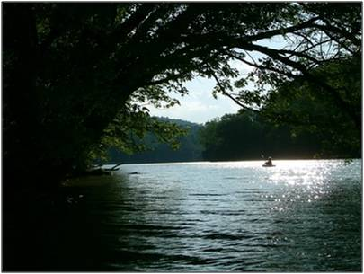
Any questions?
Notes:
.

